Slide 1
Chapter 7
Advanced SQL

Slide 2
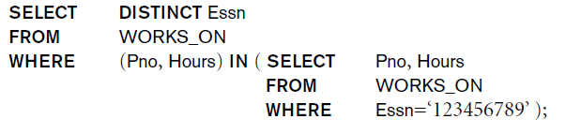
NESTING OF QUERIES
A complete SELECT query, called a nested query, can be specified within the WHERE-clause of another query, called the outer query
Many of the previous queries can be specified in an alternative form using nesting
Query 1: Retrieve the name and address of all employees who work for the 'Research' department.
Q1: SELECT FNAME, LNAME, ADDRESS FROM EMPLOYEE WHERE DNO IN
(SELECT DNUMBER FROM DEPARTMENT WHERE DNAME='Research' )

Slide 3
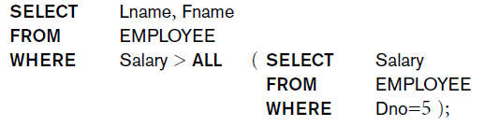
NESTING OF QUERIES (contd.)
The nested query selects the number of the 'Research' department
The outer query select an EMPLOYEE tuple if its DNO value is in the result of either nested query
The comparison operator IN compares a value v with a set (or multi-set) of values V, and evaluates to TRUE if v is one of the elements in V
In general, we can have several levels of nested queries
A reference to an unqualified attribute refers to the relation declared in the innermost nested query

Slide 4
EXPLICIT SETS
It is also possible to use an explicit (enumerated) set of values in the WHERE-clause rather than a nested query
Query 13: Retrieve the social security numbers of all employees who work on project number 1, 2, or 3.
Q13: SELECT DISTINCT ESSN FROM WORKS_ON WHERE PNO IN (1, 2, 3)

Slide 5
NULLS IN SQL QUERIES
SQL allows queries that check if a value is NULL (missing or undefined or not applicable)
SQL uses IS or IS NOT to compare NULLs because it considers each NULL value distinct from other NULL values, so equality comparison is not appropriate.
Query 14: Retrieve the names of all employees who do not have supervisors.
Q14: SELECT FNAME, LNAME FROM EMPLOYEE WHERE SUPERSSN IS NULL
Note: If a join condition is specified, tuples with NULL values for the join attributes are not included in the result
SELECT FNAME, LNAME FROM EMPLOYEE WHERE SUPERSSN IS NOT NULL

Slide 6
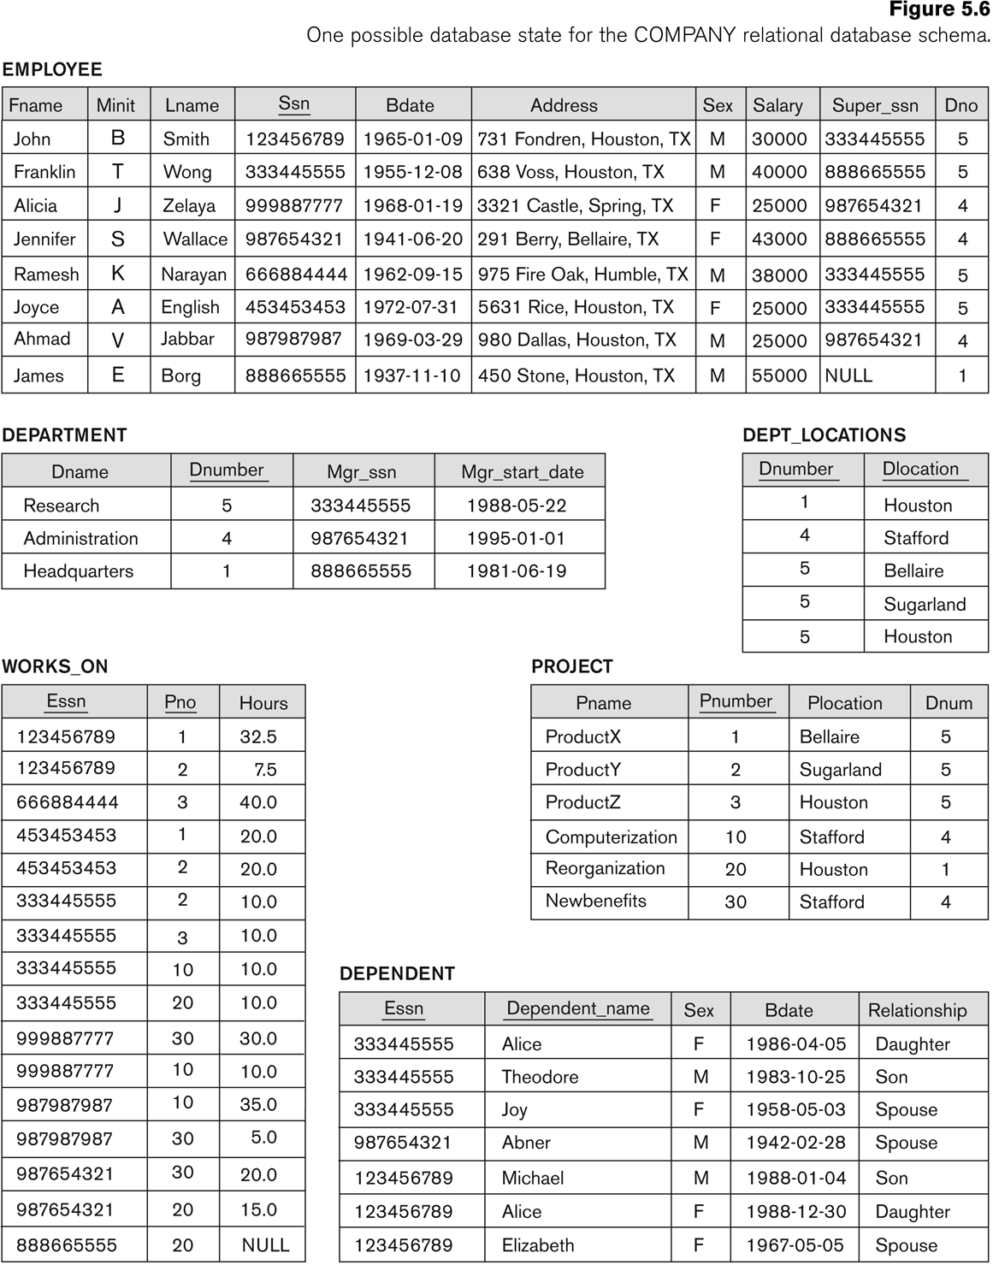
Populated database state for COMPANY

Slide 7

AGGREGATE FUNCTIONS
Include COUNT, SUM, MAX, MIN, and AVG
Query 15: Find the maximum salary, the minimum salary, and the average salary among all employees.
Q15: SELECT MAX(SALARY), MIN(SALARY), AVG(SALARY) FROM EMPLOYEE
Some SQL implementations may not allow more than one function in the SELECT-clause

Slide 8
AGGREGATE FUNCTIONS (contd.)
Query 16: Find the maximum salary, the minimum salary, and the average salary among employees who work for the 'Research' department.
Q16: SELECT MAX(SALARY), MIN(SALARY), AVG(SALARY) FROM EMPLOYEE, DEPARTMENT WHERE DNO=DNUMBER AND DNAME='Research'

Slide 9
AGGREGATE FUNCTIONS (contd.)
Queries 17 and 18: Retrieve the total number of employees in the company (Q17), and the number of employees in the 'Research' department (Q18).
Q17: SELECT COUNT (*) FROM EMPLOYEE
Q18: SELECT COUNT (*) FROM EMPLOYEE, DEPARTMENT WHERE DNO=DNUMBER AND DNAME='Research’

Slide 10
GROUPING
In many cases, we want to apply the aggregate functions to subgroups of tuples in a relation
Each subgroup of tuples consists of the set of tuples that have the same value for the grouping attribute(s)
The function is applied to each subgroup independently
SQL has a GROUP BY-clause for specifying the grouping attributes, which must also appear in the SELECT-clause

Slide 11
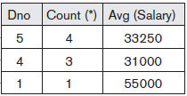
GROUPING (contd.)
Query 20: For each department, retrieve the department number, the number of employees in the department, and their average salary.
Q20: SELECT DNO, COUNT (*), AVG (SALARY) FROM EMPLOYEE GROUP BY DNO
In Q20, the EMPLOYEE tuples are divided into groups-
Each group having the same value for the grouping attribute DNO
The COUNT and AVG functions are applied to each such group of tuples separately
The SELECT-clause includes only the grouping attribute and the functions to be applied on each group of tuples
A join condition can be used in conjunction with grouping

Slide 12
GROUPING (contd.)
Query 21: For each project, retrieve the project number, project name, and the number of employees who work on that project.
Q21: SELECT PNUMBER, PNAME, COUNT (*) FROM PROJECT, WORKS_ON WHERE PNUMBER = PNO GROUP BY PNUMBER, PNAME
In this case, the grouping and functions are applied after the joining of the two relations

Slide 13
THE HAVING-CLAUSE
Sometimes we want to retrieve the values of these functions for only those groups that satisfy certain conditions
The HAVING-clause is used for specifying a selection condition on groups (rather than on individual tuples)

Slide 14
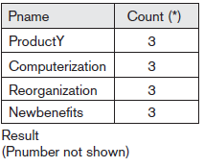
THE HAVING-CLAUSE (contd.)
Query 22: For each project on which more than two employees work, retrieve the project number, project name, and the number of employees who work on that project.
Q22: SELECT PNUMBER, PNAME, COUNT(*) FROM PROJECT, WORKS_ON WHERE PNUMBER=PNO GROUP BY PNUMBER, PNAME HAVING COUNT (*) > 2

Slide 15
Views (Virtual Tables) in SQL
A view in SQL terminology is a single table that is derived from other tables. These other tables can be base tables or previously defined views.
A view does not necessarily exist in physical form; it is considered to be a virtual table, in contrast to base tables, whose tuples are always physically stored in the database.
We can think of a view as a way of specifying a table that we need to reference frequently, even though it may not exist physically.
For example, referring to the COMPANY database we may frequently issue queries that retrieve the employee name and the project names that the employee works on. Rather than having to specify the join of the three tables EMPLOYEE,WORKS_ON, and PROJECT every time we issue this query, we can define a view that is specified as the result of these joins.

Slide 16

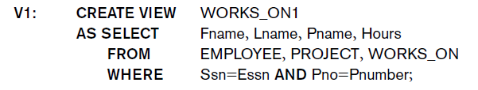
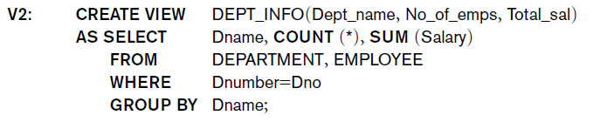

Specification of Views in SQL
In SQL, the command to specify a view is CREATE VIEW. The view is given a (virtual)
table name (or view name), a list of attribute names, and a query to specify the contents of the view. If none of the view attributes results from applying functions or arithmetic operations, we do not have to specify new attribute names for the view, since they would be the same as the names of the attributes of the defining tables in the default case.
Example 1:
Example 2:

Slide 17
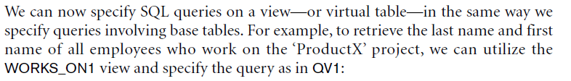

Querying Views in SQL

Slide 18
Another Example of Views in SQL
Example 3:
- CREATE View MyList
AS Select Fname, Salary, ssn
FROM Employee;
- SELECT * FROM MyList;

